Slide 1
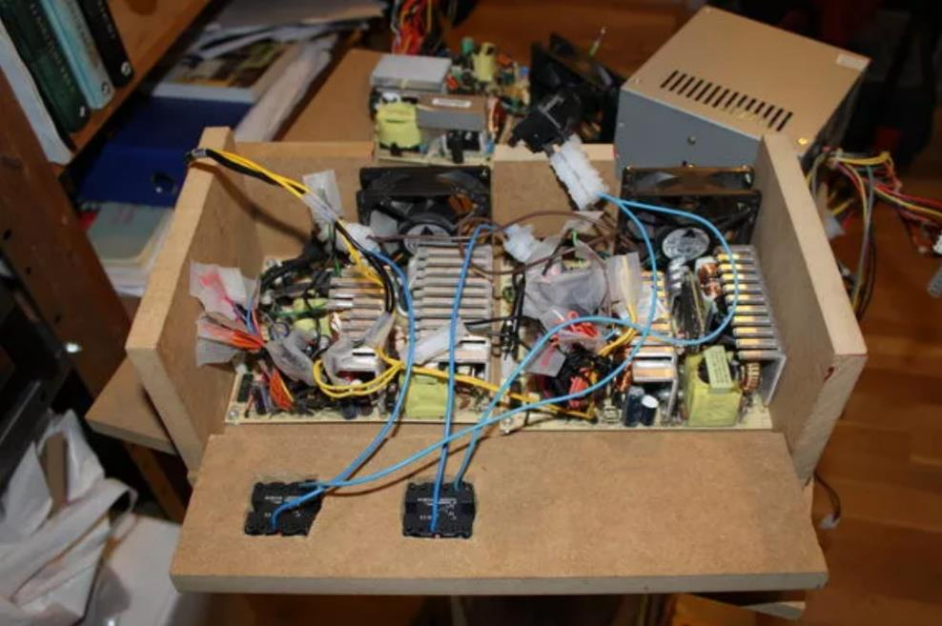
Basic Electronics Components
Mar-2019

Slide 2


Rules of thumb, assumptions and mixed-quality analogies to come!

Slide 3
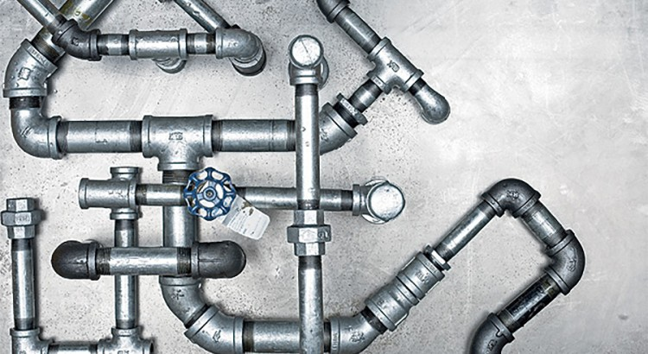
Plumbing Analogy

Slide 4
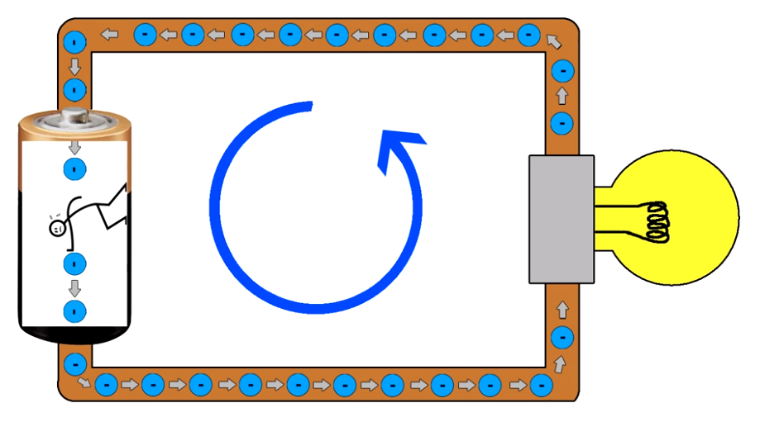
Powering a Light Bulb
Voltage is the pushing force
Pushes electrons through a circuit

Slide 5
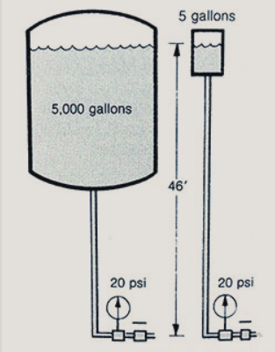
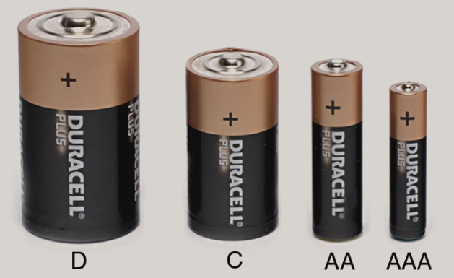
Voltage
+
+
+
+
1.5V
1.5V
1.5V
1.5V
-
-
-
-

Slide 6
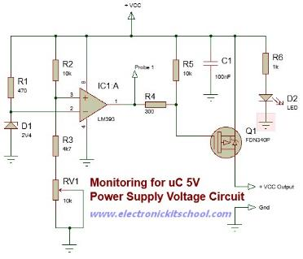
Powering a Complex Circuit
12V
Voltage is applied across any circuit to power it

Slide 7
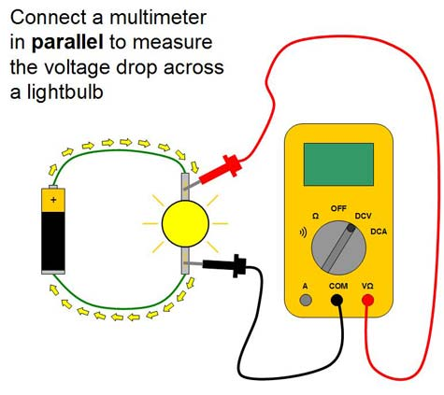
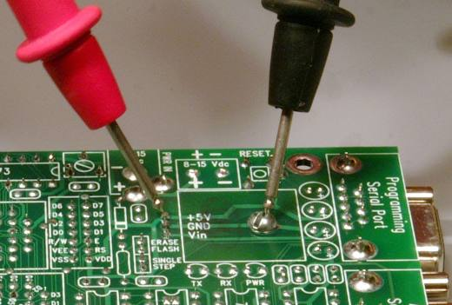
Measuring Voltage
Voltage is measured between two points:
Common (reference, ground)
Positive

Slide 8
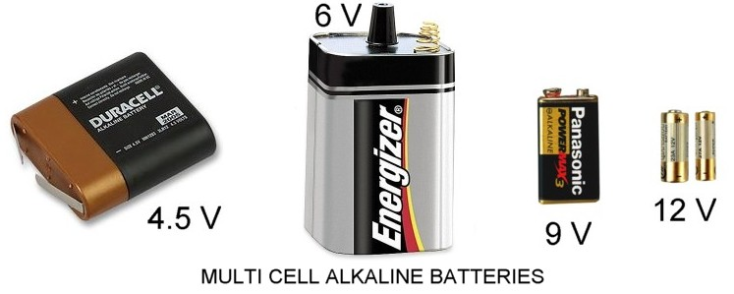

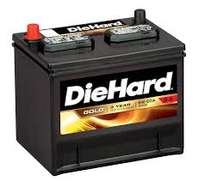
Common Voltages
Volts DC
9V or 9VDC
110 volts AC
110V or 100V AC
12V DC or
12V

Slide 9
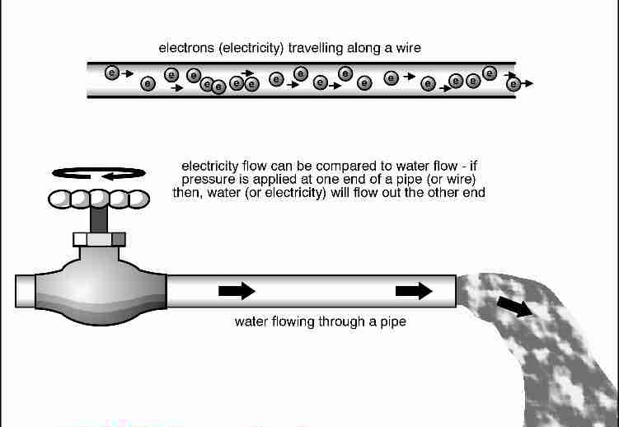
Current
Current is the flow of electrons
Similar to the flow of water

Slide 10
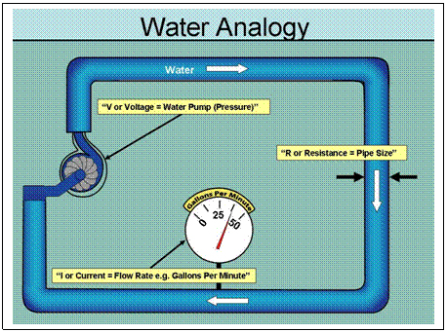
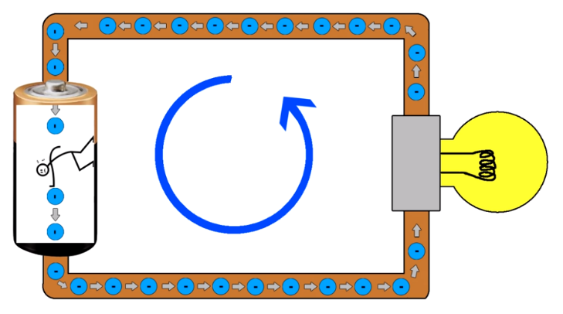
Current
Measured in amps
1A (1 amp) = 6.25 x 10¹⁸ electrons per second

Slide 11
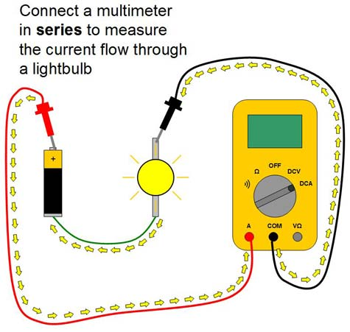
Measuring Current
Current can be measured by passing it through a multimeter

Slide 12
“Voltage Across” – “Current Through”
Voltage
Current

Slide 13
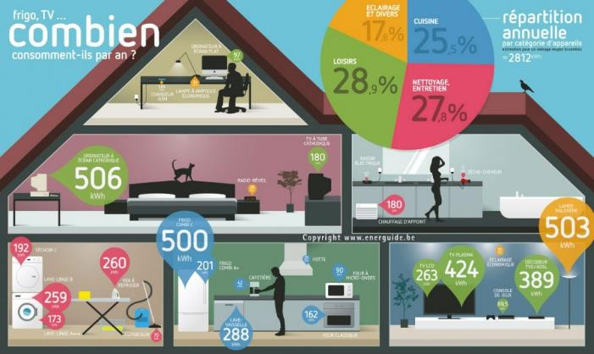
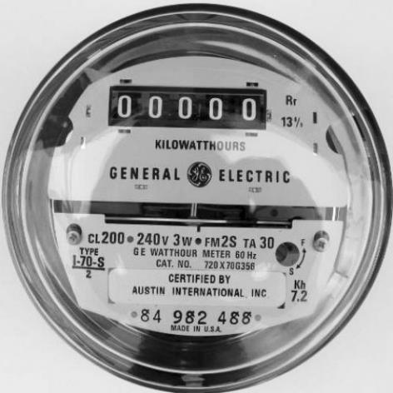
Power
Power = Watts = Amount of energy used at a particular point in time
Energy =
Power x Time = W x hr
Total energy used over a period of time

Slide 14
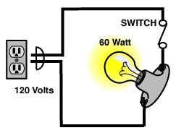
Calculating Power
Power = Voltage x Current
120V x 0.5A = 60W

Slide 15
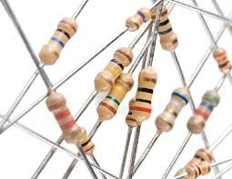
Resistors – A minute to learn, a lifetime to master

Slide 16

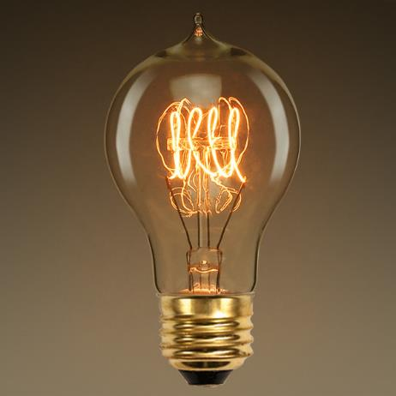
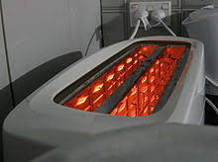

We use them every day

Slide 17
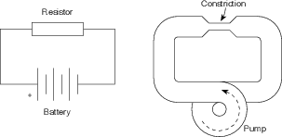
Resistors – Resist the flow of current
Resistance – measured in Ohms (Ω)

Slide 18
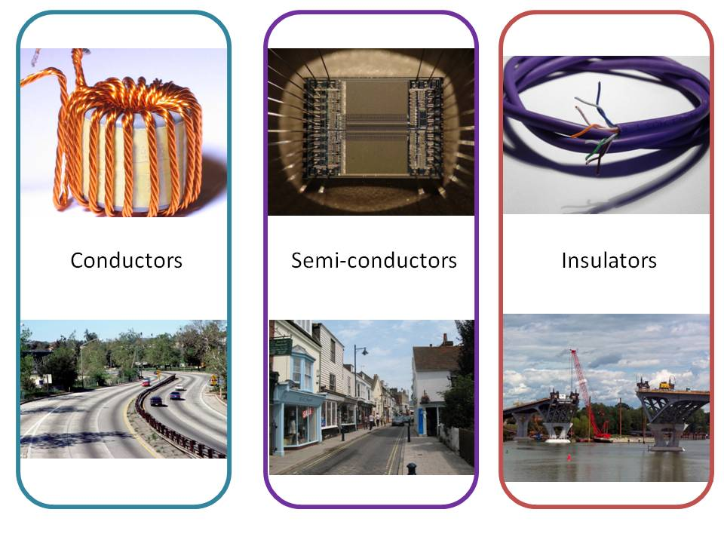
Conductors vs Insulators

Slide 19
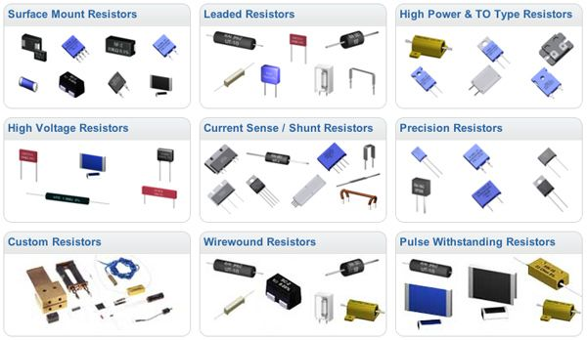
All Shapes and Sizes

Slide 20
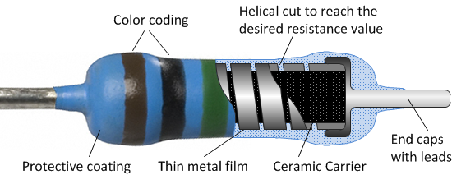
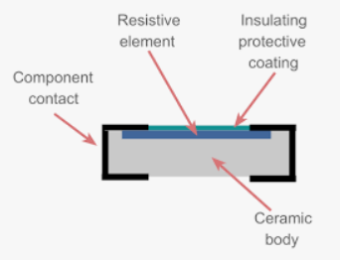
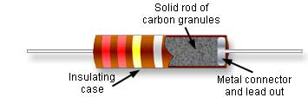
Fixed Resistors – Construction

Slide 21
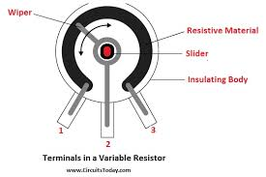
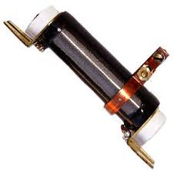
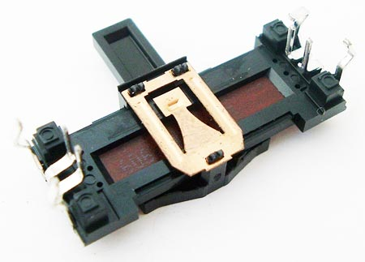
Variable Resistors – Construction

Slide 22
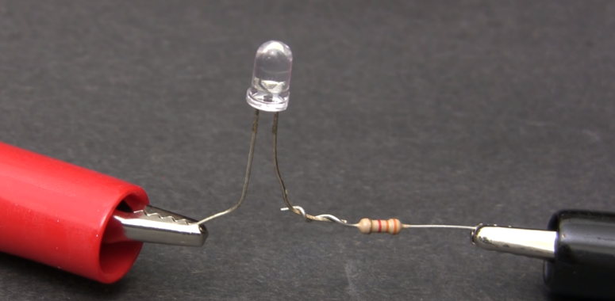
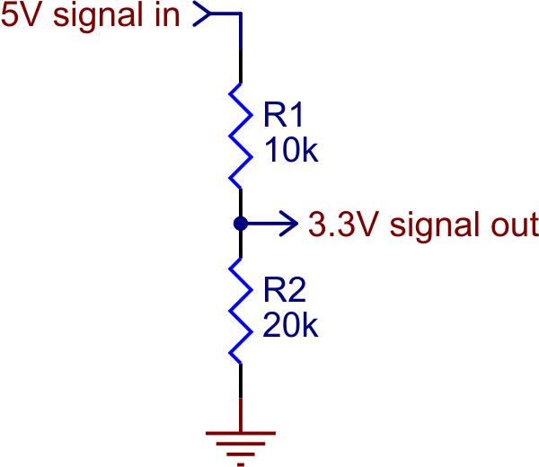
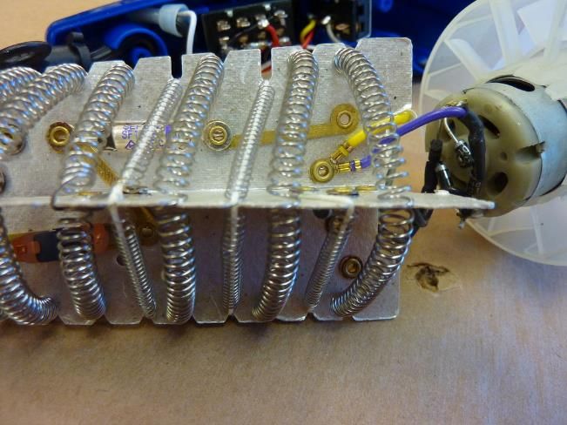
Resistors – Simple but useful!

Slide 23

Ohm’s Law
V = I * R
Special Relationship between voltage, current, resistance

Slide 24
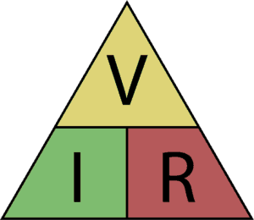
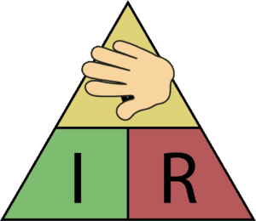
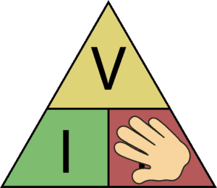
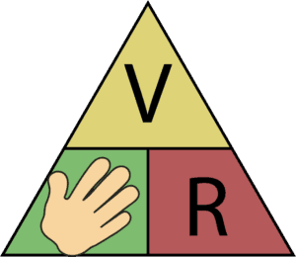
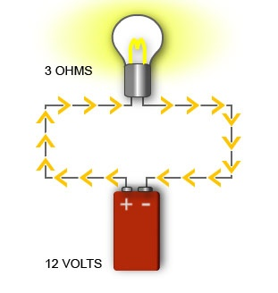
Ohm’s Law
V = I * R
R = V / I
I = V / R
R=?
I=0.5A
I=?
120V

Slide 25
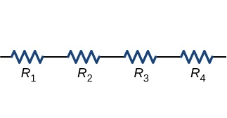

Resistors in Series
=
10Ω
10Ω
10Ω
10Ω
40Ω
R₁ + R₂ + R₃ + R₄

Slide 26
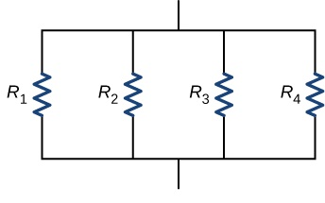

Resistors in Parallel
=
40Ω
40Ω
40Ω
40Ω
R_{T}
10Ω
1
R_{T} =
1
R₁
+
1
R₂
+
1
R₃
+
1
R₄

Slide 27
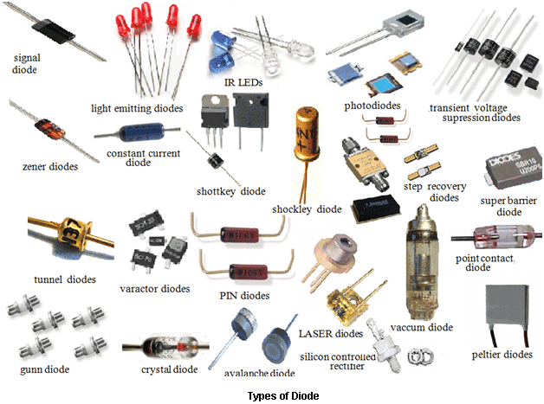
Diodes/LEDs

Slide 28
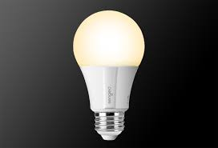

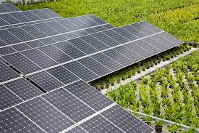
Diodes – Everyday Uses

Slide 29
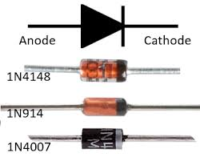
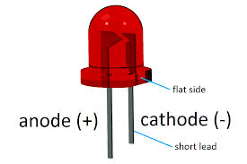
Diodes – One-Way Gate
Current Flow
LED

Slide 30
How to use a diode
I_{LED}
R
V_{S} > V_{LED} + 1V
I_{LED} ~ 10-20mA
V_{LED} ~ 1.8-3.3V
V_{S}
+
-
+
V_{LED}
-

Slide 31
Practical Circuit
I = 10mA
V_{S} = 5V
R = ?
+
-
+
V_{LED} = 2V
R = V / I
-
R = (5V – 2V) / 0.01A
= 3V / 0.01A
= 300Ω

Slide 32
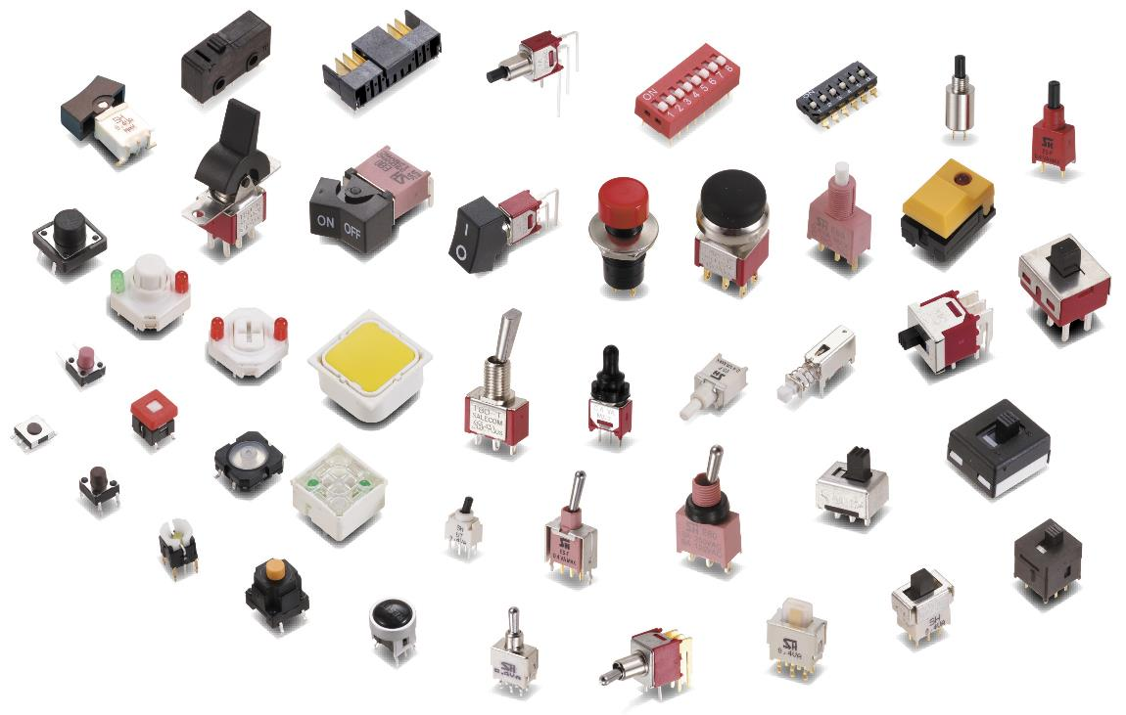
Switches

Slide 33
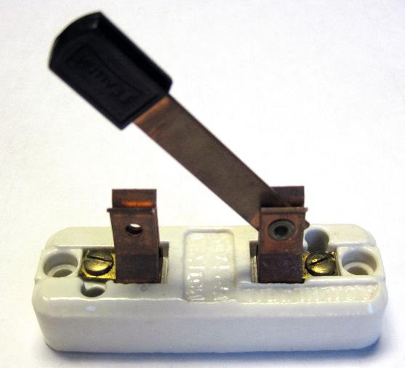
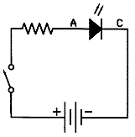
Switch Example

Slide 34
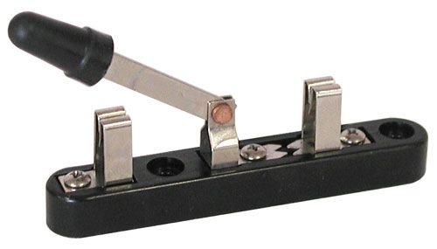
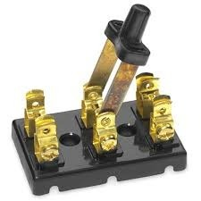
More Switch Types

Slide 35
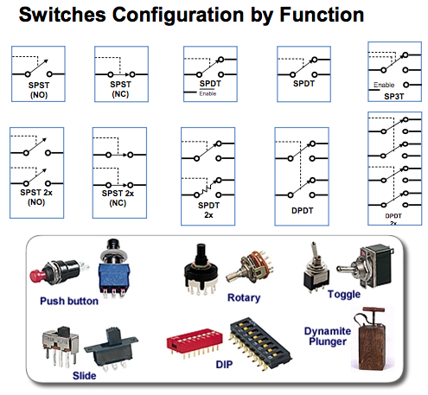
Poles and Throws

Slide 36

Capacitors

Slide 37


Similar to Batteries

Slide 38


“Supply Bypass” Capacitors

Slide 39

Capacitors in Parallel
C_{T} = C₁ + C₂ + C₃

Slide 40



Capacitors in Series
c
C_{total}
c

Slide 41
Further Reading
Falstad Circuit Simulator – Runs in Browser
Kahn Academy – Introduction to EE
Mattermost Channel
YouTube Videos
All About Circuits
https://www.allaboutcircuits.com/education/
Sparkfun – learn.sparkfun.com

